Slide 1
Windows Program with C/C++
GDI & TextOutput
FPT Software
Trainer Name – Trainer Unit

Slide 2
Agenda
Paint and Repaint
Introduction to GDI
Scrollbar

Slide 3
The Device Context (1)
A device context is everything under one name. It is an orchestra, an ensemble of what need in order to draw. It includes the platform you draw on, the dimensioning of the platform, the orientation and other variations of your drawing, the tools you need to draw on the platform, the colors, and various other accessories that can complete your imagination.
When using a computer, you certainly cannot position tools on the table or desktop for use as needed. To help with drawing on the Windows operating system, Microsoft created the Graphical Device Interface, abbreviated as GDI. It is a set of classes, functions, variables, and constants that group all or most of everything you need to draw on an application. The GDI is provided as a library called Gdi.dll and is already installed on your computer.
HDC: This is the most fundamental class to draw in your applications. It provides all of the primary functions used to perform the basic drawing steps. In order to use this class, first declare a variable from it. Then call the BeginPaint() function to initialize the variable using the PAINSTRUCT class. Once the variable has been initialized, you can use it to draw. After using the device context call the EndPaint() function to terminate the drawing.

Slide 4
The Device Context (2)
In order to draw using a device context, you must first declare an HDC variable. This can be done as follows:
HDC hDC;
After declaring this variable, you must prepare the application to paint by initializing it with a call to the BeginPaint() function. The syntax of the BeginPaint() function is:
HDC BeginPaint(HWND hWnd, LPPAINTSTRUCT lpPaint);
  The hwnd argument is a handle to the window on which you will be painting
  The lpPaint argument is a pointer to the PAINTSTRUCT structure. This means that, the BeginPaint() function returns two values. It returns a device context as HDC and it returns information about the painting job that was performed. That painting job is stored in a PAINTSTRUCT value
The PAINTSTRUCT structure is defined as follows:
typedef struct tagPAINTSTRUCT
{
HDC hdc;
BOOL fErase;
RECT rcPaint;
BOOL fRestore;
BOOL fIncUpdate;
BYTE rgbReserved[32];
} PAINTSTRUCT, *PPAINTSTRUCT;

Slide 5
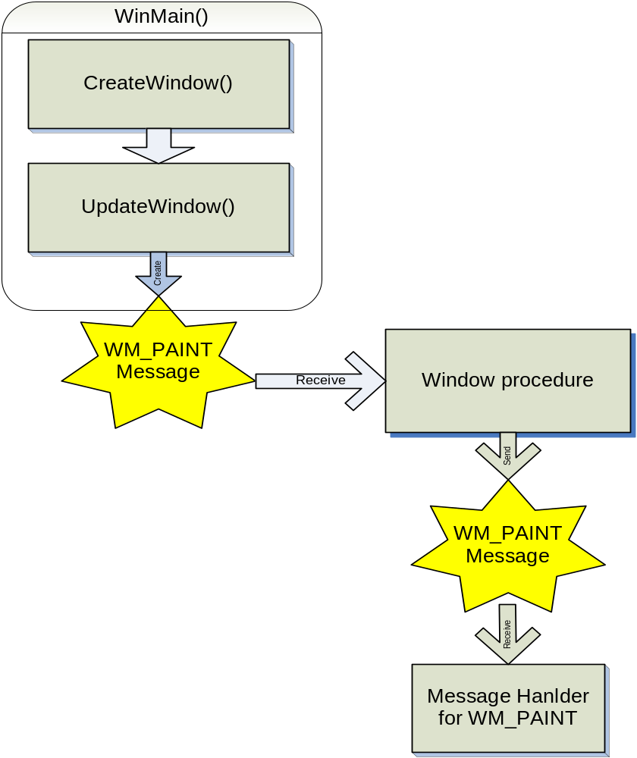
WM_PAINT Message
Informs to window procedure that window’s client area needs be repainting

Slide 6
WM_PAINT Message
Window procedure receives WM_PAINT message when :
  A previous hidden area of the window is brought to view
  Change size of window
  Use ScrollWindow() or ScrollDC() function for scroll window’s client area
  Use InvalidateRect() or InvalidateRgn() function to explicitly generate a WM_PAINT message

Slide 7
Invalid & Valid Rectangle
Actually, window procedure needs to update only a small are in client area of window. This area is known as “invalidate region” or “update region”
Window procedure will receive a WM_PAINT message only if part of client area is invalid
The smallest rectangle that encompasses the invalid region is known as “invalid rectangle”

Slide 8
Getting Device Context
Method 1 : Use in WM_PAINT event handler
  PAINTSTRUCT ps;
  HDC hDC;
  Case WM_PAINT :
    hDC = BeginPaint(hWnd, &ps);
    [Use GDI’s functions for drawing to window]
    EndPaint(hWnd, &ps);
    Return 0;

Slide 9
Getting Device Context
Method 2 : Use in other message hanlders
  HDC hDC;
  hDC = GetDC (hWnd);
  [Use GDI’s functions]
  ReleaseDC (hWnd, hDC);

Slide 10
Graphic Drawing Functions (1)
COLORREF GetPixel(HDC hDC, int nXPos, int nYPos);
Lấy về giá trị màu tại vị trí (nXPos, nYPos) của hDC, trả về -1 nếu điểm này nằm ngoài vùng hiển thị.
COLORREF SetPixel(HDC hDC, int nXPos, int nYPos, COLORREF clrRef);
Vẽ một điểm màu clrRef tại vị trí (nXPos, nYPos) lên hDC. Giá trị trả về là màu của điểm (nXPos, nYPos) hoặc -1 nếu điểm này nằm ngoài vùng hiển thị.
DWORD MoveToEx(HDC hDC, int x, int y);
Di chuyển bút vẽ đến tọa độ (x, y) trên hDC. Giá trị trả về là tọa độ cũ của bút vẽ, x = LOWORD, y = HIWORD.
BOOL LineTo(HDC hDC, int xEnd, int yEnd);
Vẽ đoạn thẳng từ vị trí hiện hành đến vị trí (xEnd, yEnd) trên hDC. Hàm trả về TRUE nếu thành công, FALSE nếu thất bại.

Slide 11
Graphic Drawing Functions (2)
BOOL Polyline(HDC hdc, CONST POINT *lppt, int cPoints);
BOOL PolylineTo(HDC hdc, CONST POINT *lppt, DWORD cCount);
Draw a series of connected lines
BOOL PolyPolyline(HDC hdc, CONST POINT *lppt, CONST DWORD *lpdwPolyPoints, DWORD cCount);
draw various polylines in one step
BOOL Polygon(HDC hdc, CONST POINT *lpPoints, int nCount);
A polygon is a closed polyline. In other words, it is a polyline defined so that the end point of the last line is connected to the start point of the first line.
BOOL Rectangle(HDC hdc, int nLeftRect, int nTopRect, int nRightRect, int nBottomRect);
Draw a rectangle

Slide 12
TextOut() Function
Most common GDI function for display text on window
Prototype :
  BOOL TextOut(
  HDC hdc, // handle to DC
  int nXStart, // x-coordinate of starting position
  int nYStart, // y-coordinate of starting position
  LPCTSTR lpString, // character string
  int cbString // number of characters
  );

Slide 13
TextOutput
System Font
Size of a Character
Text Metrics
Formatting Text

Slide 14
Size of Character
Information about size of character is stored in struct TEXTMETRIC
  typedef struct tagTEXTMETRIC {
    LONG tmHeight ;
    LONG tmAscent ;
    LONG tmDescent ;
    LONG tmInternalLeading ;
    LONG tmExternalLeading ;
    LONG tmAveCharWidth ;
    LONG tmMaxCharWidth ;
    [other structure fields]
    } TEXTMETRIC, * PTEXTMETRIC ;

Slide 15
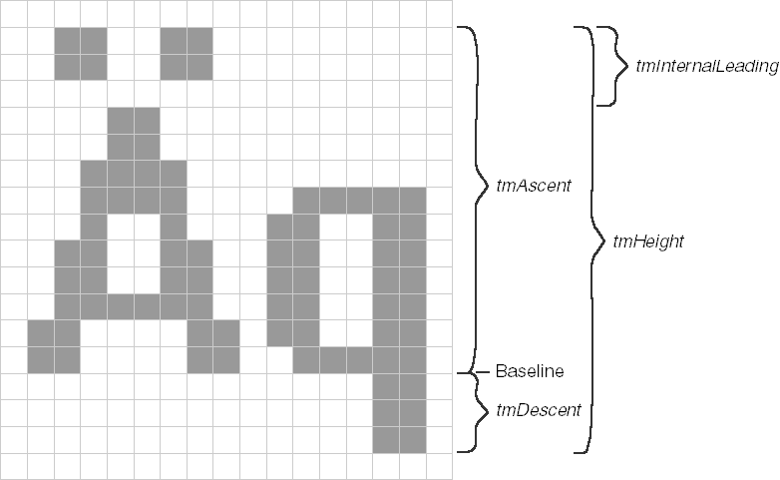
Size of Character

Slide 16
TextOut function example
HFONT hfnt, hOldFont;
hfnt = GetStockObject(ANSI_VAR_FONT);
if (hOldFont = SelectObject(hdc, hfnt))
{
TextOut(hdc, 10, 50, “Display sample font”, 18);
SelectObject(hdc, hOldFont);
}

Slide 17
DISCUSSION

